Slide 1

Rakan Mohammed Alharbi
MTA Turnstile Data: Exploratory Data Analysis

Slide 2
summary:
Exploratory Data Analysis Using Python, I'll Explore the NYC MTA Spinning Engine data set. Tracking entrances and exits every four hours for revolving doors (UNIT) daily In the subway system. Also calculate the total daily entries and exits, add up And sort the total number of passengers for each station, so I can see which of them The stations have the highest traffic during the time I achieve

Slide 3
Variables included in initially processed data:
C/A = Control Area (e.g., A002)
unit = Remote Unit for a station (e.g., R051)
SCP = Subunit Channel Position represents an specific address for a device (e.g., 02-00-00)
station_code = C/A + unit, locating a station
turnstile = C/A + unit + SCP, locating a turnstile
Station = Represents the station name the device is located at
date = Represents the date (MM-DD-YY)
time = Represents the time (hh:mm:ss) for a scheduled audit event
datetime = date + time (MM-DD-YY hh:mm:ss)
desc = Represent the "REGULAR" scheduled audit event (Normally occurs every 4 hours)
entries = The comulative entry register value for a device
exits = The cumulative exit register value for a device

Slide 4
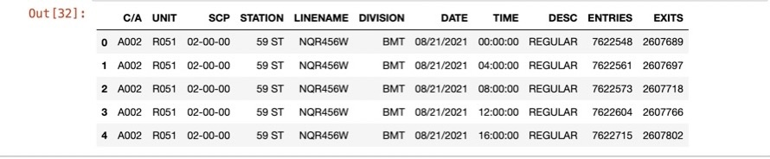
Download some MTA turnstile data files and read the files).

Slide 5
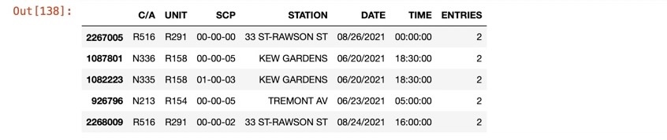
remove duplicates,
Sanity check to verify that "C/A", "UNIT", "SCP", "STATION", "DATE_TIME" is unique

Slide 6
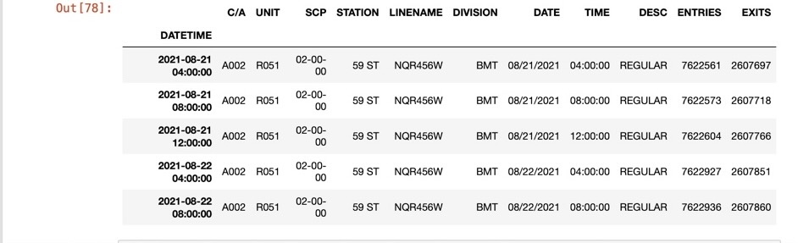
filter dataset to 4am to noon

Slide 7
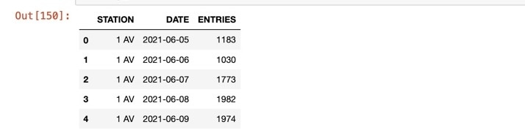
add up total morning entrants of station

Slide 8
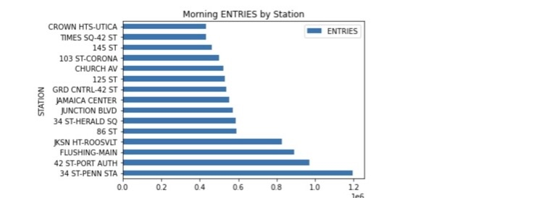
determine busiest stations

Slide 9
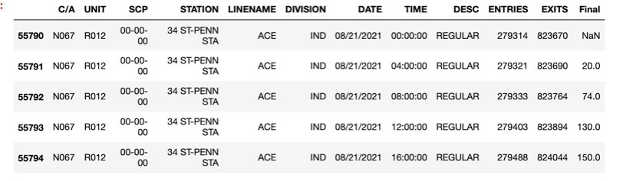
34 ST-PENN STTA data

Slide 10
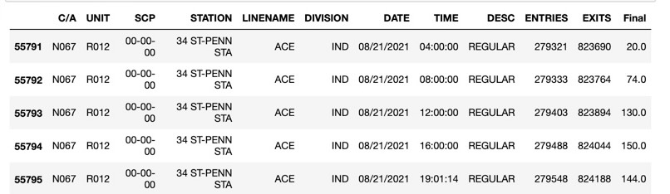
remove NaN values and negative values

